Slide 1

Dance Mode
A Spotify Recommendation System
By: Ishita Raval and Aleksander Rodriguez
Professor: Yang Zhang
Group: 5
DTSC 4050

Slide 2

Introduction
Who are we?
Aleksander Rodriguez, Ishita Raval
Why did this interest us?
We are both avid Spotify users, and want to foster our love for music.

Slide 3

Context
Platforms like Spotify and Apple Music strive to offer personalized recommendations for their users. In today’s society, the race is to make user experience platforms more personalized. With more than 100 million songs and 675 million monthly active users, Spotify is tasked to select music according to every user’s mood or preference. This must all be done in the background where Data Science plays a crucial role. Data Science is used to recommend, and predict music based on every specific user. With an abundance of songs and users, the usage of leveraging data analytics and machine learning is essential.

Slide 4

Idea/Goal
Our idea is to leverage python using packages like Pandas, Numpy, Pycaret, and Matplotlib to perform the data analysis process and create machine learning to create a dance mode.
The goal is to improve the user experience when listening and dancing to music using a songs danceability.

Slide 5
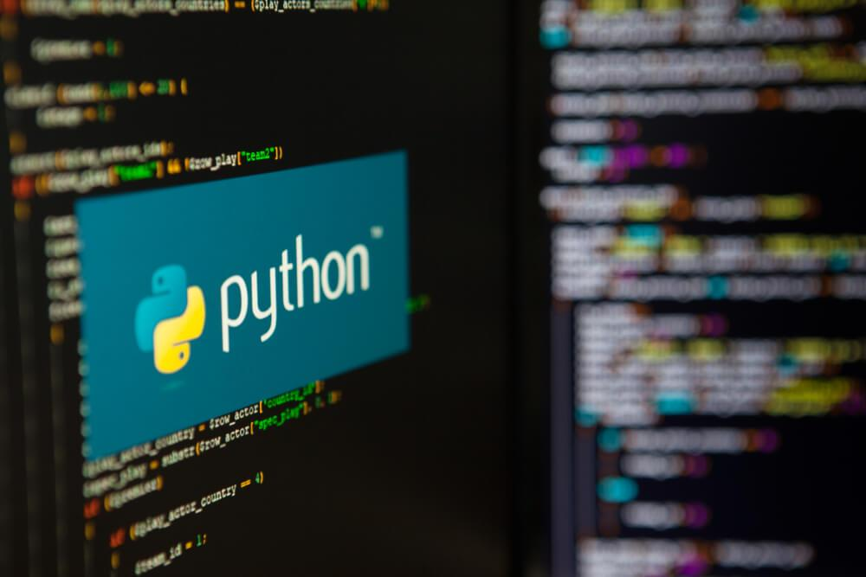
Context/Idea
The data we are using was found on Kaggle.com, it consist of 29 columns and 3146 rows.
The dataset is arranged from Spotify's API using two separate python scripts to extract popular and non-popular songs and their associated audio and descriptive features. Descriptive features of a song include information about the song such as the artist name, album name and release date. Audio features include key, valence, danceability and energy which are results of spotify's audio analysis

Slide 6

Existing Methodologies
Existing Spotify Recommendation system and “Taste Profile”
Spotify users are recommended songs and made specialized playlists for based on user data and listening history
It is centered around audio analysis, natural language processing and collaborative filtering
Music Recommendation GitHub Projects:
Music Recommendation System
Explore Spotify
Spotify Song Recommender
Spotify Recommendation System
Notes:
Spotify already has a recommendation system BUT our goal is to improve it
For each link, expand on projects to then link into the proposed meth
Spotify takes existing individual’s data and recommends similar songs, OUR goal is to introduce users to new genres and different songs, almost like a explorative rec system.?

Slide 7
Existing Methodologies
Music Recommendation System: The goal of this project was to discover a way for the machine learning model to continuously learn and recommend music for users. They used acoustic-ness, danceability, energy, instrumentalness, and several other variables
Explore Spotify: An App to explore spotify using a users top artists and tracks to create a playlist of recommendations. They were able to connect Spotify to their own app and then create a playlist. They used React, HTML, and JavaScript
Spotify Song Recommender: Used a Spotify API to generate song recommendations based off of song data in a provided playlist. They used jupyter notebook to create a neural network model
Spotify Recommendation System: The goal of this project is to recommend songs to help users discover new music and to keep them engaged with the platform. Their project consisted of finding the best model to complete their goal
Notes:
Spotify already has a recommendation system BUT our goal is to improve it
For each link, expand on projects to then link into the proposed meth
Spotify takes existing individual’s data and recommends similar songs, OUR goal is to introduce users to new genres and different songs, almost like a explorative rec system.?

Slide 8
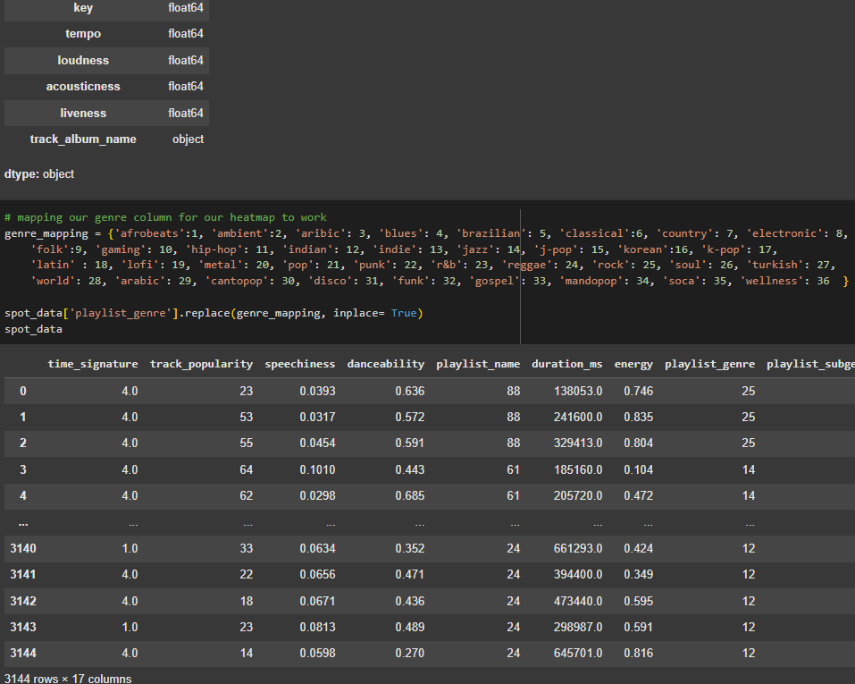
Clean and Understand
To begin we explored our null values which we concluded to drop rows with nulls
Ensured all the attributes/columns were in their respected data types
Encoded genre, subgenre, and playlist_name by mapping them
Dropped unnecessary columns. These columns were track_album_release_date, id, and track_album_name
Notes:
Spotify already has a recommendation system BUT our goal is to improve it
For each link, expand on projects to then link into the proposed meth
Spotify takes existing individual’s data and recommends similar songs, OUR goal is to introduce users to new genres and different songs, almost like a explorative rec system.?

Slide 9
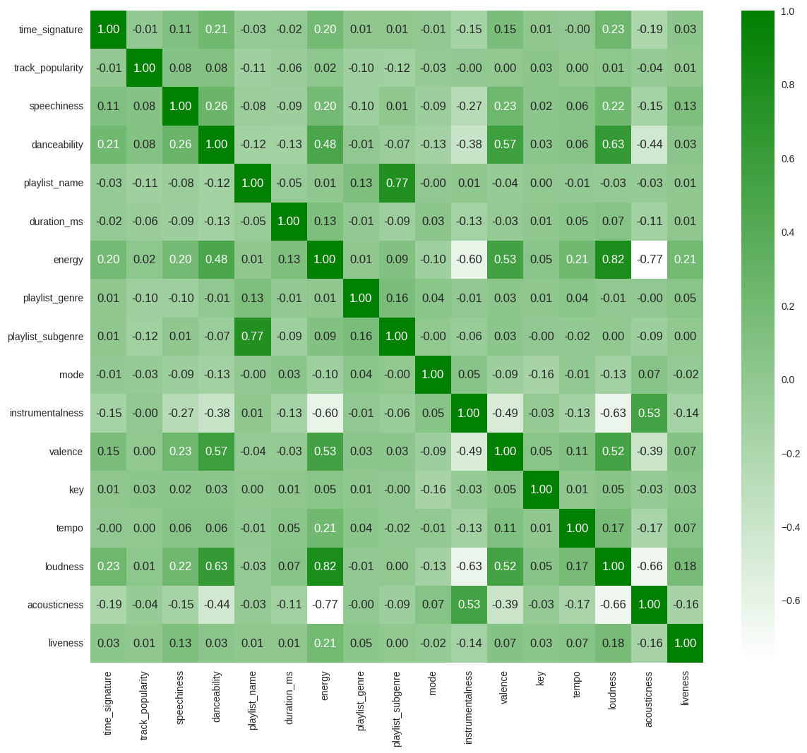
Analyze The Data
Our main source of analyzing our data before the model was our heatmap
This gives us a generalized idea of what variables have strong correlations
The main focus is danceability:
Strong Positives: Speechiness, Energy, Valence, Loudness
Strong Negatives: Duration_ms, Instrumentalness, Acousticness
Notes:
Spotify already has a recommendation system BUT our goal is to improve it
For each link, expand on projects to then link into the proposed meth
Spotify takes existing individual’s data and recommends similar songs, OUR goal is to introduce users to new genres and different songs, almost like a explorative rec system.?

Slide 10
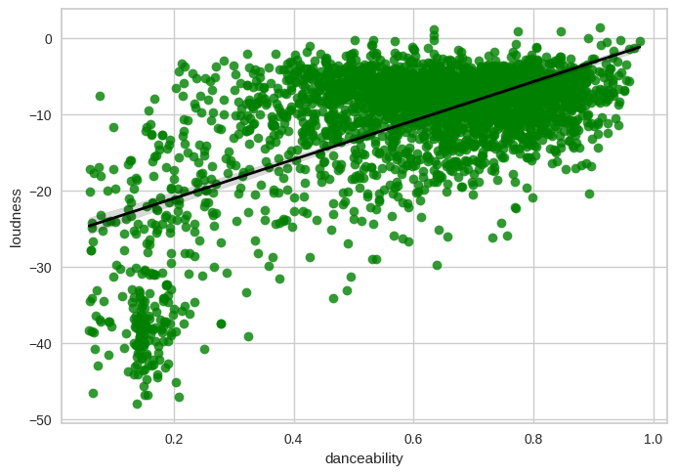
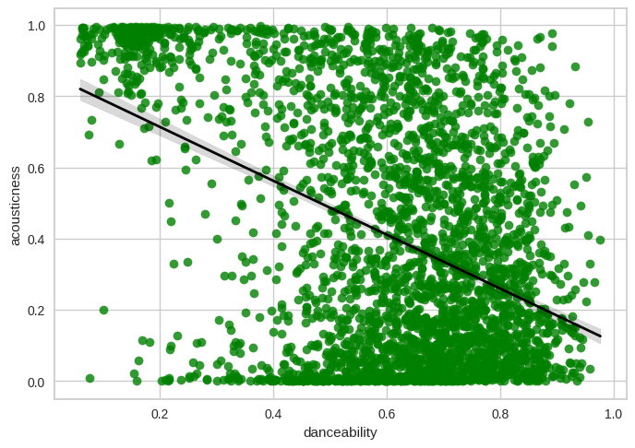
Analyze The Data
Strong Positives: In the upper graph, is an example of a strong positive variable
Strong Negatives: In the lower graph, is an example of a strong negative variable
Both are good correlations. A positive correlation consists of danceability and the y variable are both going up and down at the same time.
Negative would be the x variable going up but the danceability going down and vice versa.
Notes:
Spotify already has a recommendation system BUT our goal is to improve it
For each link, expand on projects to then link into the proposed meth
Spotify takes existing individual’s data and recommends similar songs, OUR goal is to introduce users to new genres and different songs, almost like a explorative rec system.?

Slide 11
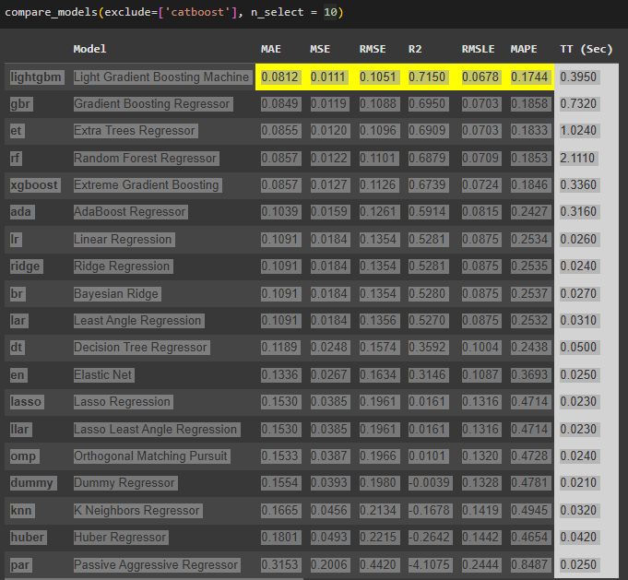
Create The Model
We used the Pycaret library within python to create our models
The setup() was used created to target danceability in our model
Also used the compare_models() to find the model that best fit our data. Result was: Light Gradient Boosting Machine Model
Notes:
Spotify already has a recommendation system BUT our goal is to improve it
For each link, expand on projects to then link into the proposed meth
Spotify takes existing individual’s data and recommends similar songs, OUR goal is to introduce users to new genres and different songs, almost like a explorative rec system.?

Slide 12
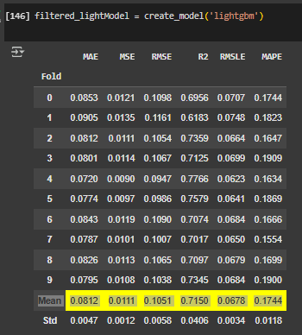
Analyze The Model
R-Squared: Model can capture the variation of the target about 71.5% of the time
Root Mean Squared Error: The average size of the prediction errors was about .1051
Train Time (From last slide): The train time was under half a second at .3950sec which is very efficient compared to other models
Notes:
Spotify already has a recommendation system BUT our goal is to improve it
For each link, expand on projects to then link into the proposed meth
Spotify takes existing individual’s data and recommends similar songs, OUR goal is to introduce users to new genres and different songs, almost like a explorative rec system.?

Slide 13
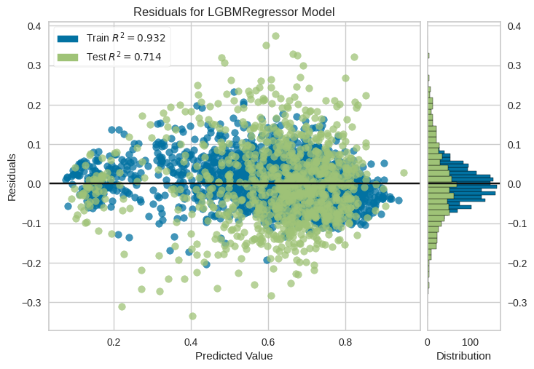
Model Conclusion
Train R² is very high, meaning the dataset fits the model well
The Test R² is at .714 which means that our model can perform well on new data
The histogram depicts the distributions of the residuals.
Centered around 0: means that errors are small
Symmetrical: means equal positive and negative errors
Few Outliers/Overall balanced
Notes:
Input and output goals
Think pseudocode emphasis on the pseudo/ steps to success ts
Recommending from low popularity to intro users to more unknown but similar songs
Recc danceable songs to “dancers” target audience
Time sig, track popularity speechiness, energy, balance, key, temp, loudness, liveliness

Slide 14

Finished Goal
This is only the beginning of a project that holds the potential to become a valuable feature within Spotify.
We were able to create a model that can accurately predict danceability according to the descriptive features stats of songs.
Using a song’s acousticness, loudness, instrumentalness, and valance, etc. our model was able to be efficient and contributional to our end goal.

Slide 15

Possibilities
This model could be the backbone of a bigger and more powerful project. Our idea is to use this project to make a dance mode tailored for users. The model created in this project could be in the background for a feature tailored to every user on the app according to genres they like to listen to. The model creation for our project was a simple implementation, which can allow anyone to interchange danceability to another variable they want to predict.

Slide 16

How Spotify Could Benefit
The ultimate goal of creating Dance Mode is to add another feature to the Spotify app, enhancing the user experience to its max. With premium subscriptions, users are able to have endless skips and streaming capabilities. Upon fully developing and refining a Dance Mode with our model in the background, Spotify could use the dance mode as an additional premium feature that users can access any time to get danceable, high energy songs catered to them, and according to their taste.

Slide 17
References
Prasad, Sathish. “SATHISHPRASAD/Music-Recommendation-System: This Repository Contains the Implementation of a Music Recommendation System Using the Spotify Dataset from Kaggle. the System Is Built with Machine Learning Techniques to Suggest Songs to Users Based on Their Listening History and Preferences.” GitHub, 2023, github.com/sathishprasad/Music-Recommendation-System.
Abdelrhmanelruby. “Abdelrhmanelruby/Spotify-Recommendation-System: Spotify Recommendation System Using Spotify Million Playlist Dataset.” GitHub, github.com/abdelrhmanelruby/Spotify-Recommendation-System. Accessed 26 Feb. 2025.
BobbyWilt. “Bobbywilt/Spotify_song_recommender: This Project Leverages Spotify’s API and Provided User Playlists to Create and Tune a Neural Network Model That Generates Song Recommendations Based off of Song Data in Provided Playlists.” GitHub, github.com/BobbyWilt/Spotify_Song_Recommender. Accessed 26 Feb. 2025.
“Understanding Recommendations on Spotify.” Safety & Privacy Center, www.spotify.com/us/safetyandprivacy/understanding-recommendations. Accessed 26 Feb. 2025.
Notes:
Context behind systems used ex spotify

